Slide 1
How to draw the front of a face
www.tinkelstar.be

Slide 2
NOSE DRAWING LESSONS
By tinkelstar.be
1…

Slide 3
1…
www.tinkelstar.be

Slide 4
NOSE DRAWING LESSONS
By tinkelstar.be
2…

Slide 5
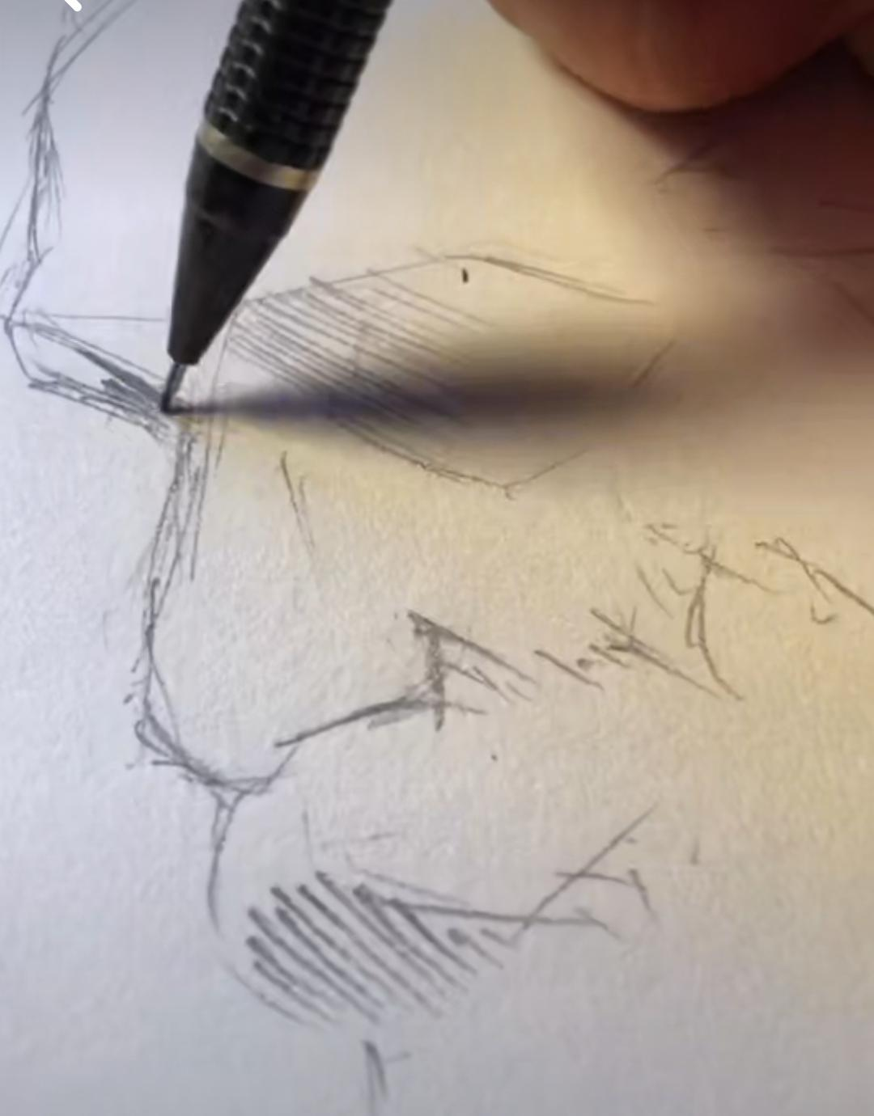
www.tinkelstar.be
2…

Slide 6
NOSE DRAWING LESSONS
By tinkelstar.be
3…

Slide 7
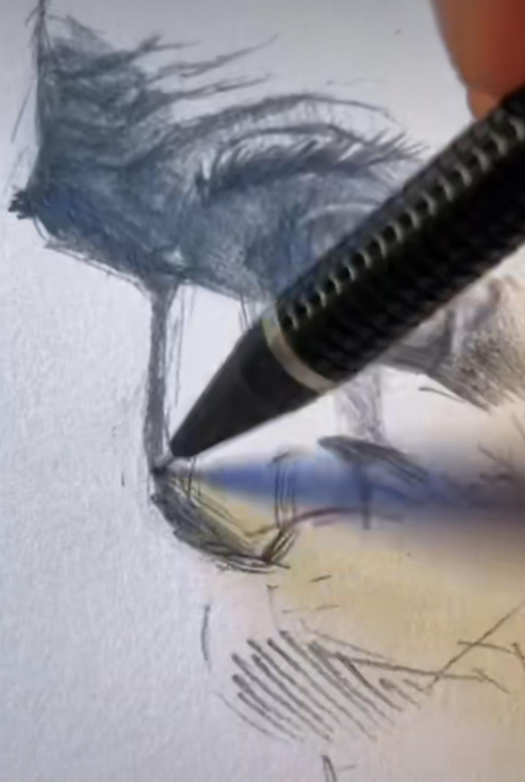
www.tinkelstar.be
3…

Slide 8
NOSE DRAWING LESSONS
By tinkelstar.be
4…

Slide 9
www.tinkelstar.be
4…

Slide 10
NOSE DRAWING LESSONS
By tinkelstar.be
5…

Slide 11
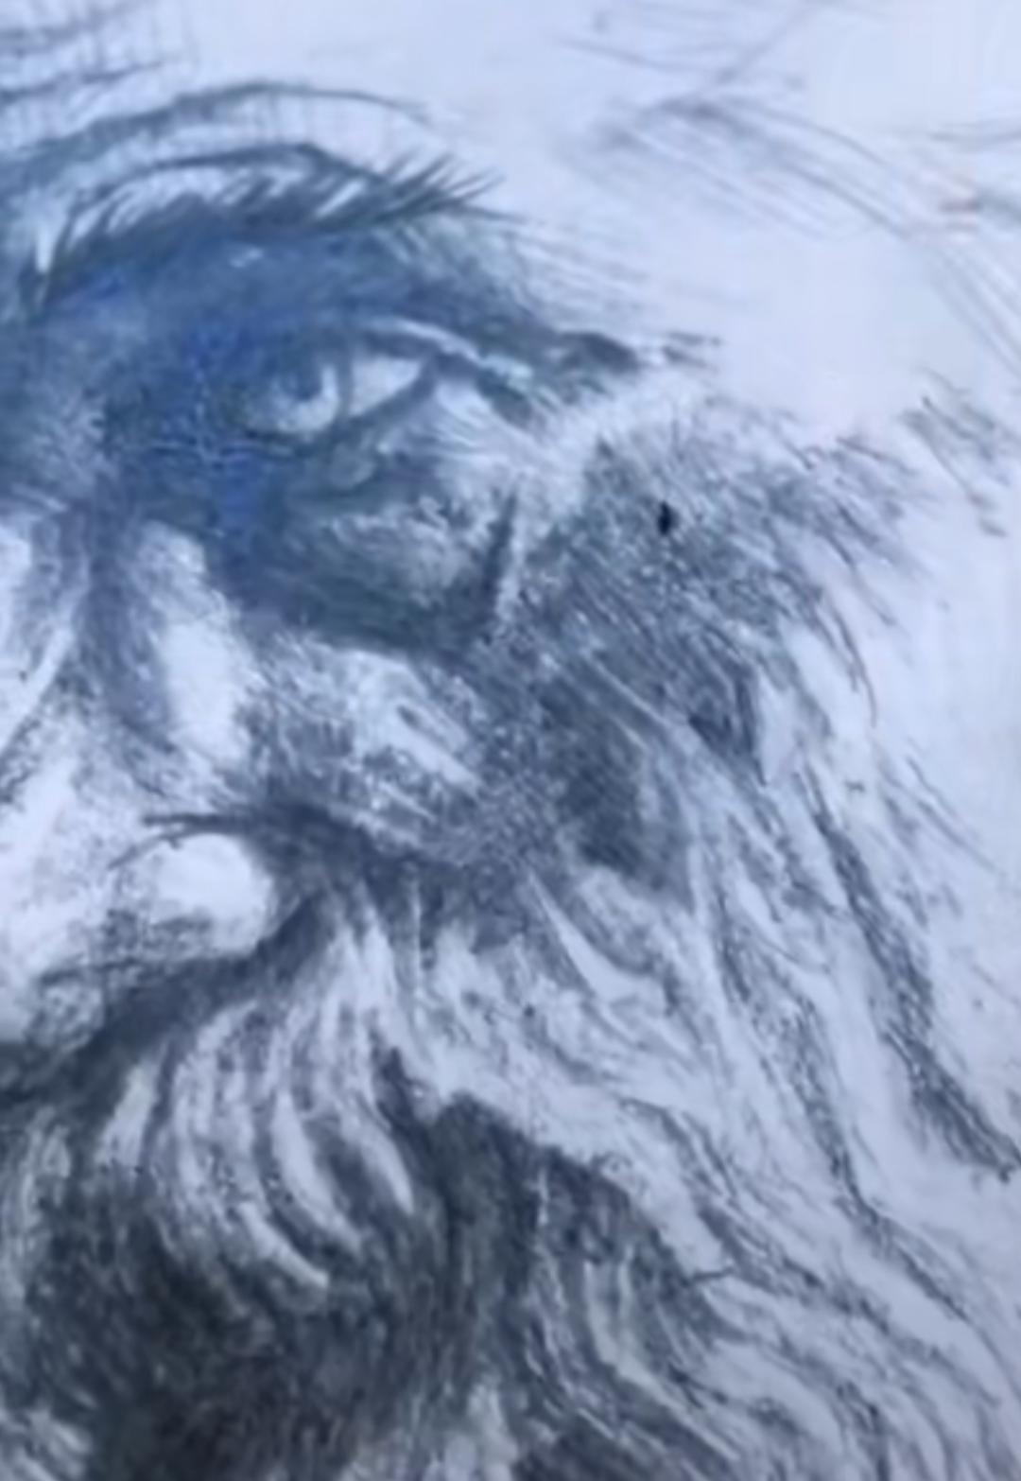
www.tinkelstar.be
5…

Slide 12
…The End…
www.tinkelstar.be

